Slide 1
Notes:
Note to Teacher:
This PowerPoint presentation should be used in Slideshow View to display animated sequences.

Slide 2
Learning Intentions : By the end of this topic I will be able to :
Explain how an earthquake occurs using key terminology and diagrams.
Describe where earthquakes occur and why
Describe the economic and social impacts of earthquakes on Chilke and Nepal

Slide 3
Class 1
Key terms
Seismologist
Shock waves/Seismic waves
Magnitude
Epicentre
Focus
Fault line

Slide 4
Ian Stewart Convection Currents
18:20

Slide 5
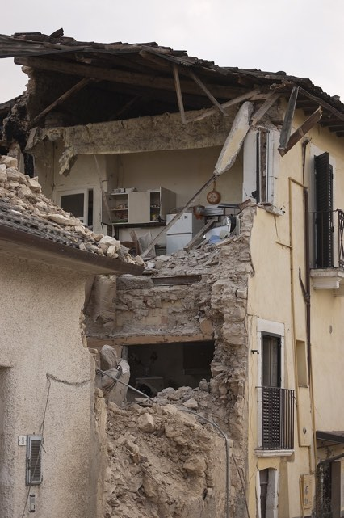
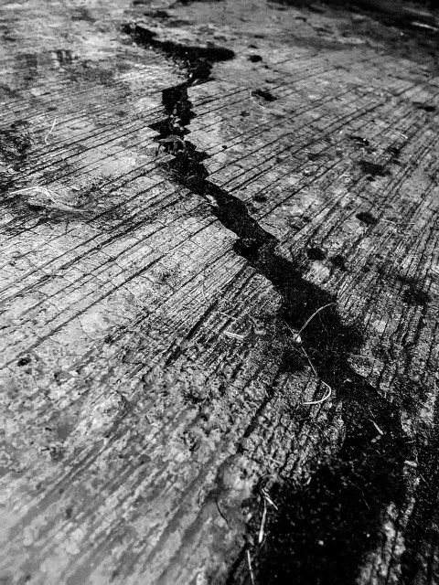
3.1
Studying Earthquakes
An earthquake is the sudden shaking of the earth caused by the movement of the earth’s crust.
Most earthquakes occur along the edges of large plates, where they collide or slide past each other.
Seismologists are scientists who study earthquakes and try predict when they might occur again

Slide 6
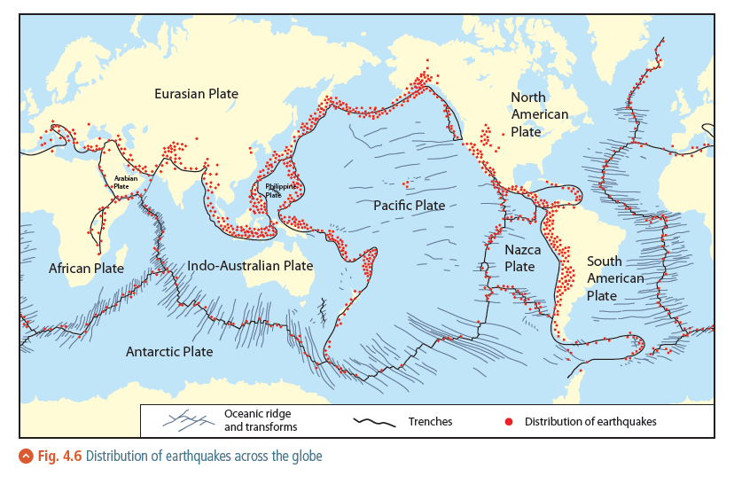
Locations of Earthquakes
Nearly all earthquakes across the globe occur at plate boundaries, with 80 per cent of all seismic activity occurring along the Pacific Ocean’s subduction zones.

Slide 7
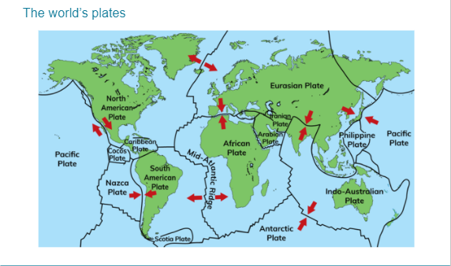

Slide 8
Earthquakes Why? Clip 2
https://www.youtube.com/watch?v=e7ho6z32yyo
Earthquakes 101 | National Geographic – YouTube
https://www.youtube.com/watch?v=QogJIQV83pY&list=PLpSrprQMbT1enjASJNldamFYLzzQjQI2B&index=15

Slide 9
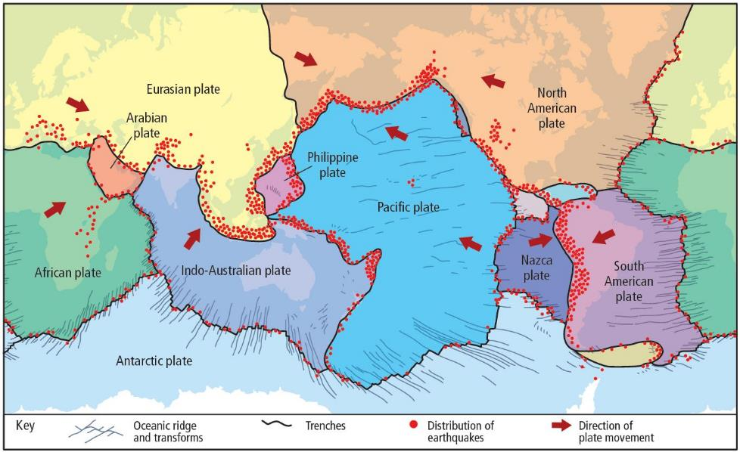
Earthquake Distribution

Slide 10
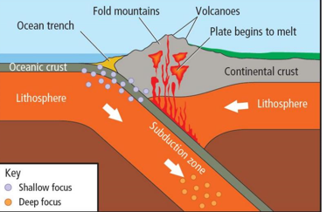

Slide 11
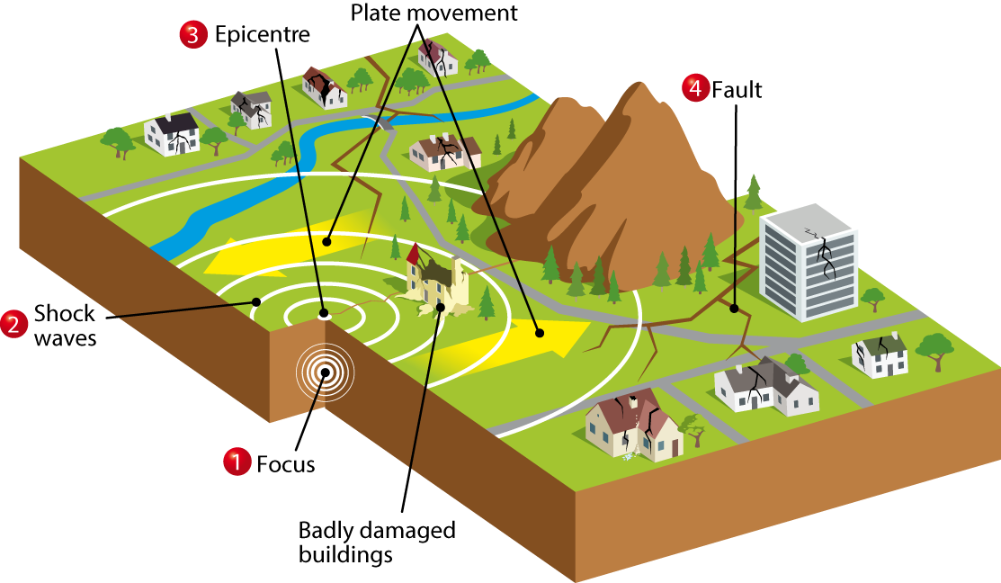
3.2
Earthquakes
Focus: The place where an earthquake begins beneath the earth’s surface.
Shock waves: Also called ‘seismic waves’. These spread out in circles from the focus.
Epicentre: The point on the earth’s surface that is directly above the focus of the earthquake.
Fault: A large crack in the earth’s crust.

Slide 12
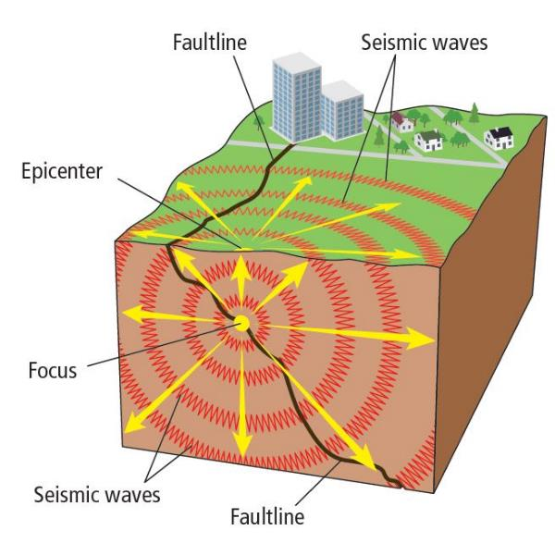
Parts of an Earthquake
Fault line: the fracture in the rock caused when plates move.
Focus: point on the fault line where the earthquake begins.
Seismic waves: vibrations caused by the earthquake sent out from the focus.
Epicentre: the point on the surface directly above the focus, where seismic waves are strongest.
Aftershocks: smaller earthquakes that follow the main-shock.

Slide 13
Measuring Earthquakes
The strength of an earthquake is called its magnitude.

Slide 14
Seismograph
The instrument used to measure and record an earthquake and how long it lasted is the seismograph
This Photo by Unknown Author is licensed under CC BY-SA

Slide 15
Richter Scale
Original scale used to measure the magnitude of an earthquake.
Each one unit increase means the earthquake is ten times more powerful.
This Photo by Unknown Author is licensed under CC BY-SA-NC

Slide 16
Moment Magnitude Scale
It has replaced the Richter scale as it is more reliable.
The scale goes from 1-10.
It also uses ground movement to measure the earthquakes strength.
This Photo by Unknown Author is licensed under CC BY-SA

Slide 17
3.4
Measuring Earthquakes
Seismograph | The instrument used to measure and record an earthquake and how long it lasted. Phone apps today allow you to carry your own seismograph in your pocket!
Richter scale | The original scale used to measure the magnitude (strength) of an earthquake. This scale goes from 1 to 8. Each one-unit increase means that the earthquake is ten times more powerful than it was at the previous unit.
Moment magnitude scale | Used to measure the magnitude of earthquakes. It replaced the Richter scale because it is more reliable for larger earthquakes. The scale goes from 1 to 10.

Slide 18
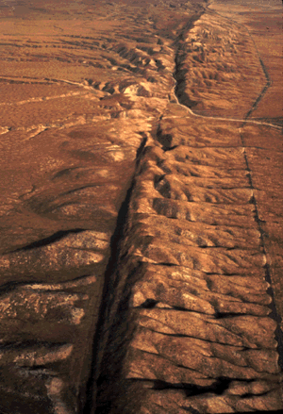
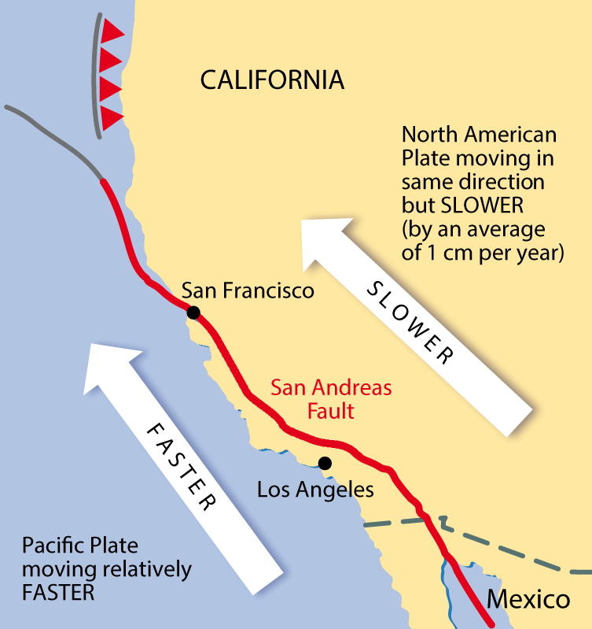
3.1
Studying Earthquakes
The San Andreas Fault
A large crack in the earth’s crust that marks a plate boundary
Located in California
Slow-moving North American plate
Faster-moving Pacific plate
When the plates touch, they can lock together
An earthquake occurs when one plate suddenly jumps forward, slips or breaks

Slide 19
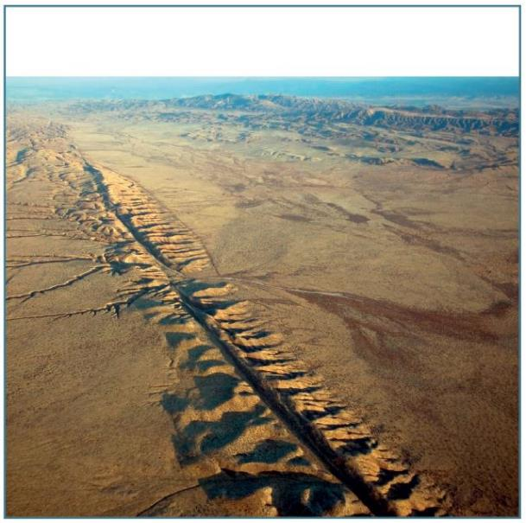
San Andreas Fault
Triggered where two plates slide past each other.
Friction causes the plates to lock together.
Pressure and stress build up until the rock breaks and the plate jolts forward, triggering an earthquake.
E.g. San Andreas Fault lies on the boundary between Pacific and North American plates.

Slide 20
San Francisco Earthquakes
1906
The 1906 San Francisco earthquake struck the coast of Northern California at 5:12 a.m. on Wednesday, April 18, with an estimated moment magnitude of 7.9 and a maximum Mercalli intensity of XI (Extreme). ... The events are remembered as one of the worst and deadliest earthquakes in the history of the United States.
San Francisco Earthquake of 1989
On October 17, 1989, a magnitude 6.9 earthquake hit the San Francisco Bay Area, killing 67 people and causing more than $5 billion in damages.

Slide 21
San Francisco 1989 Footage
https://www.youtube.com/watch?v=Z7eABGpOHv8&list=PLpSrprQMbT1cZ579bgFYft1PVY9lnRca2&index=101&t=236s

Slide 22
Ian Stewart Berkley College

Slide 23
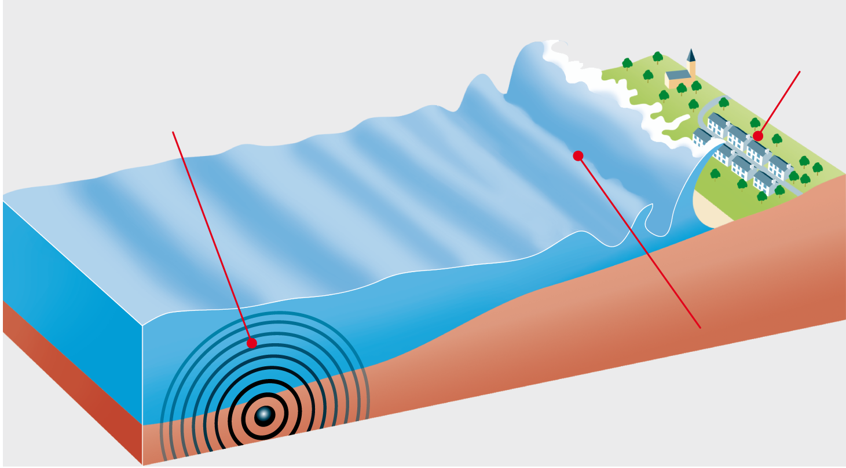
3.3
Tsunami Waves
How a tsunami happens
A tsunami can devastate low-lying areas.
An undersea earthquake disturbs the seabed and causes power waves to move out quickly in all directions.
The waves become
much higher as they approach
shallow water near the coast.

